Slide 1
DS530 Week 5

Slide 2
Week | Objective | Assignment Deadlines
1/18/24 | Introduction to Big Data and Data Engineering
1/25/24 | Big Data and Data Engineering Cont.
2/1/24 | Data Warehouse vs. Data Lakes | Read Chapters 1-2
2/8/224 | Hadoop and MapReduce | Read Chapter 3
2/15/24 | Intro to Snowflake | Read Chapter 4
2/22/24 | Snowflake Cont. | Complete Data Warehouse Badge

Slide 3







Modern Data Stack
Ingestion
Data Storage
Data Source
Data
Transformation
Data Analysis

Slide 4
Data Warehouse

Slide 5
Data Warehouse
Coined by Bill Irmon in the 1970s
“Subject-oriented, integrated, time-variant, and nonvolatile collection of data”
Purpose is to centralize data from multiple sources
Be able to transform the data from multiple sources for a coherent analysis

Slide 6
Data Warehouse – On Premise
Early implementations of a data warehouse was on premise
Run on computer servers within the datacenter
Very costly
Hardware
Human resources
Hard to maintain
Complex architecture
Not scalable

Slide 7
Data Warehouse – On Cloud
Rise of Big Data through the ecommerce boom pushed on premise Data Warehouses to cloud based environments
Flexible
Scalable
Cost Effective

Slide 8



Data Warehouse – On the Cloud

Slide 10
Introduction/History
Created by two Oracle Architects in 2012
Benoit Dageville
Thierry Cruanes
Data Warehouses were extremely expensive and difficult to maintain
Era of Cloud Computing was pivotal in the creation
Benoit and Dageville created a solution that became one of the first pure cloud computing data storage softwares
https://www.drift.com/blog/how-snowflake-grew/

Slide 11
Benefits of Snowflake
Benefits
Serverless architecture – can use SQL queries for analysis
Built in machine learning
Geospatial Analysis
Security for collaboration
Data Clean Rooms
Monitor the flow of all data
https://www.snowflake.com/en/data-cloud/workloads/data-warehouse/

Slide 12
Benefits – Administration
Does not need installation of any software
Environments are already handled by Snowflake Co.
Users will have the support from Snowflake administrators
Resources/advance training is outsourced
Liability will of overall management and updates rely on Snowflake as a company

Slide 13
Snowflake Architecture

Slide 14



Architecture
Data Storage
Query Processing
Cloud Services

Slide 15
Data Storage
Snowflake will enrich the data into an organized tabular format
Dependent on Admin creating the ingestion pipeline

Slide 16
Query Processing
Within the Ingestion Layer
Each Virtual Warehouse will process each query
Virtual Warehouse – is a cluster of compute resources to be able to process SQL queries throughout the cloud
Resources would be the Memory, Temporary Storage (staging)
https://docs.snowflake.com/en/user-guide/warehouses

Slide 17



Cloud Service
https://docs.snowflake.com/en/user-guide/intro-cloud-platforms

Slide 18

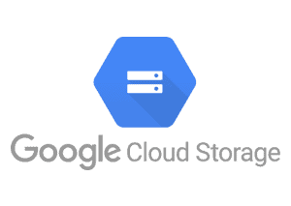
Cloud Service – Data Loading

Slide 19
Terminology
ACCOUNTADMIN
SYSADMIN
SECURITYADM
SYSADMIN
USERADMIN
PUBLIC

Slide 20




Deeper Dive into Industry Modern Data Stack
Data Modeling
EDA
Ingestion
Data Storage
Data Source
Data
Transformation
Data Analysis

Slide 21
Review of SQL

Slide 22
Syntax
Each query being produced must end with “;”
Capitalization does not matter for logic statements
Database information has to match exactly
https://www.w3schools.com/sql/sql_intro.asp

Slide 23
Select
To extract data from the table being called
select (insert column name) from (table name) = selects specific columns
select * from (table name) = selects all columns
* = all columns

Slide 24
To Delete a Database
DROP
DROP (insert table);

Slide 25
To Delete Data From a Table
Truncate
TRUNCATE TABLE LU_SOIL_TYPE;

Slide 26
Setting UP Snowflake Environment

Slide 27
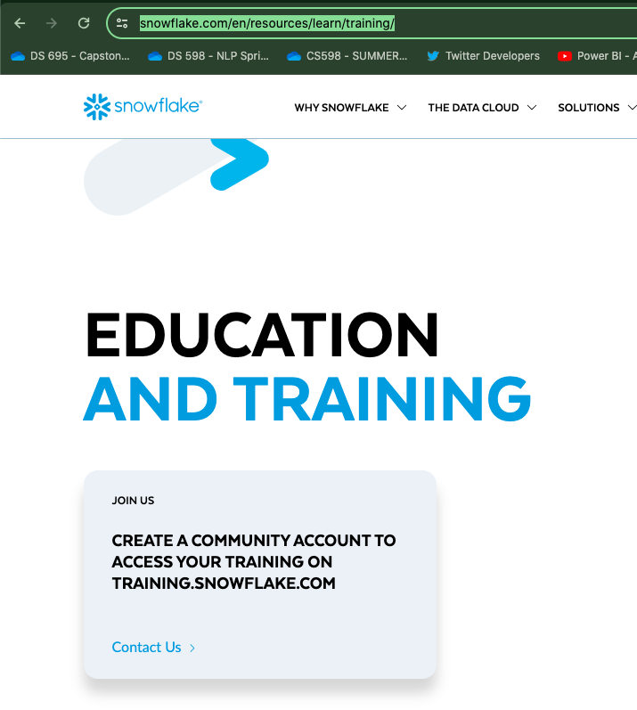
https://www.snowflake.com/en/resources/learn/training/

Slide 28
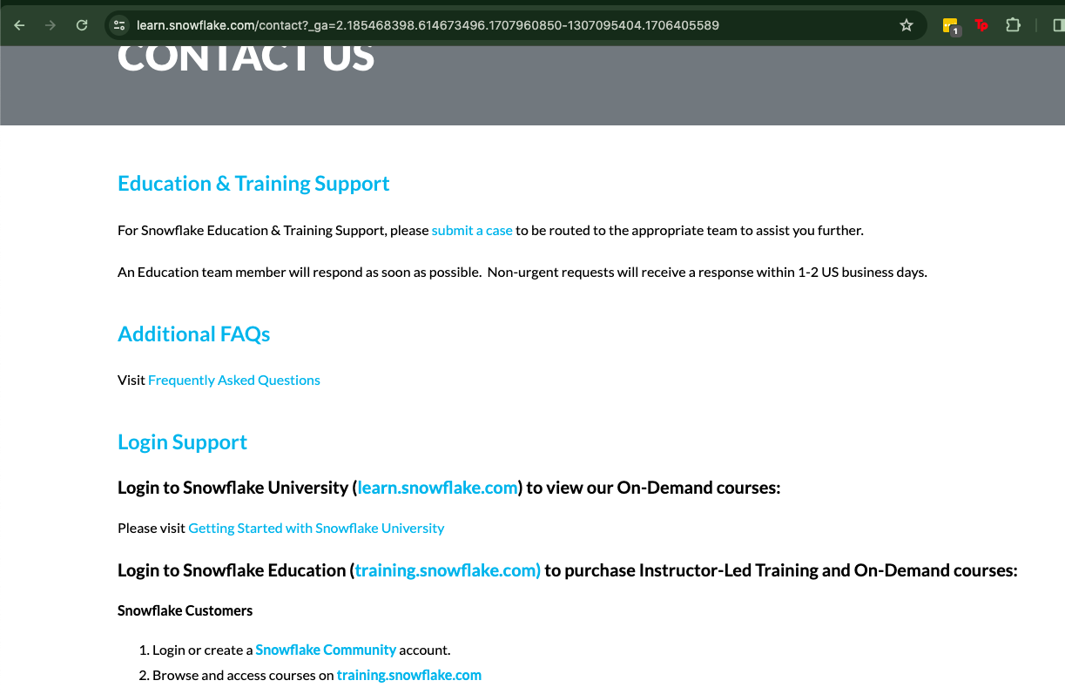

Slide 29
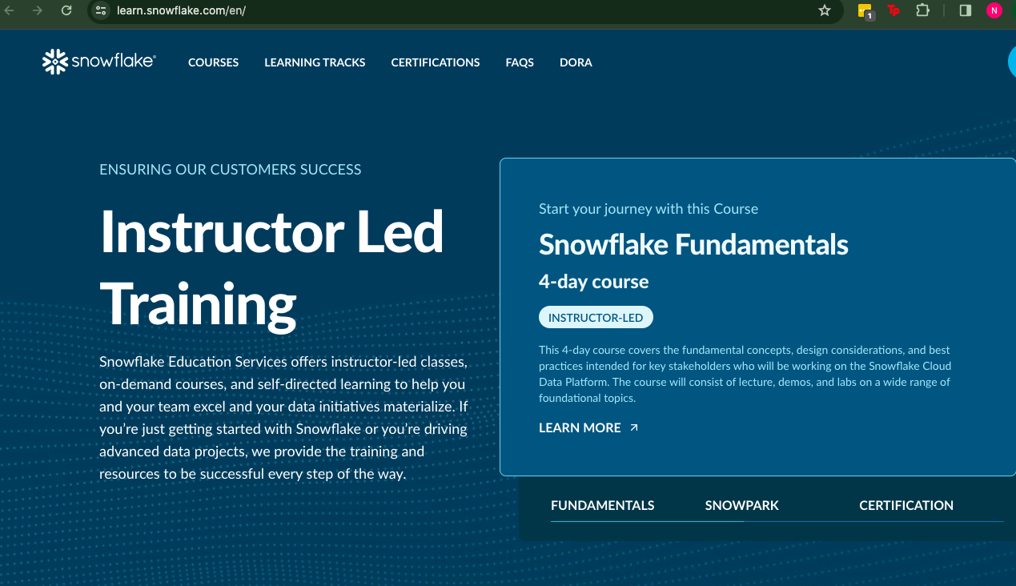

Slide 30
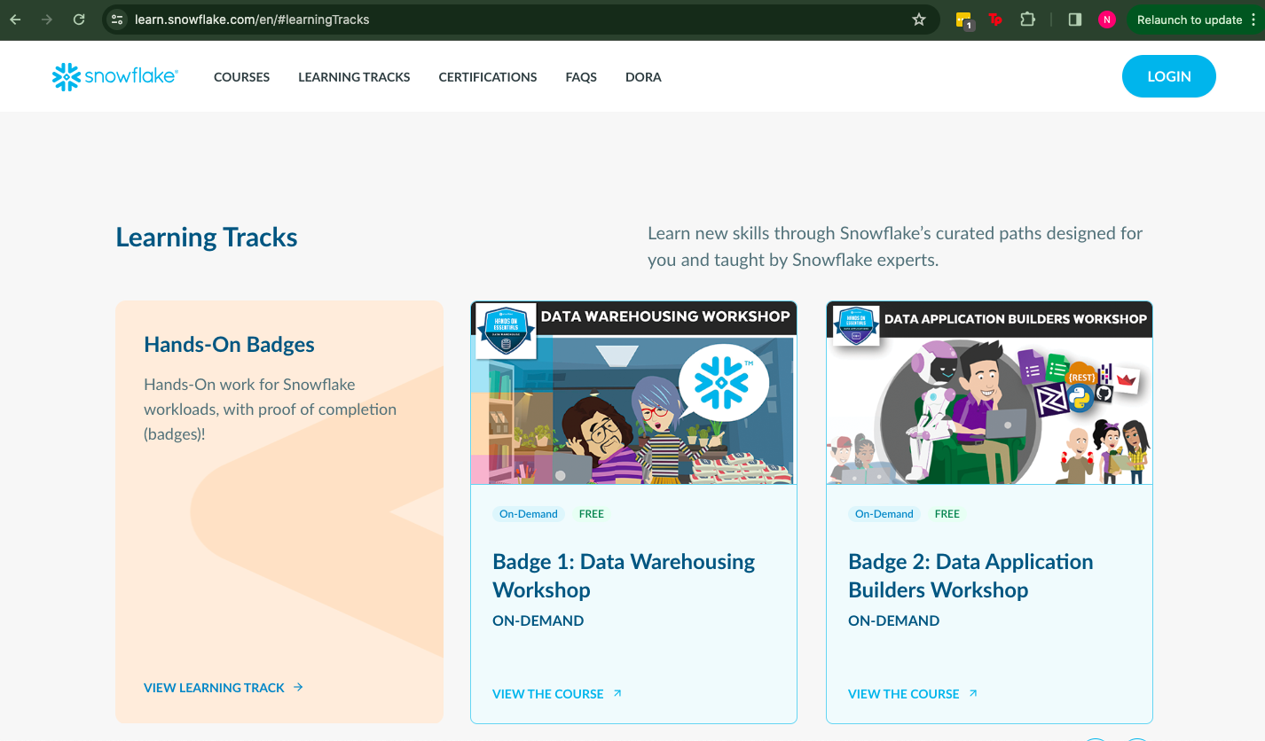

Slide 31
